Slide 1
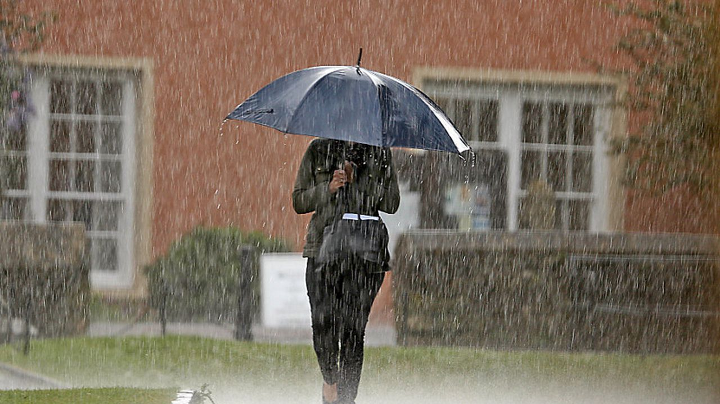
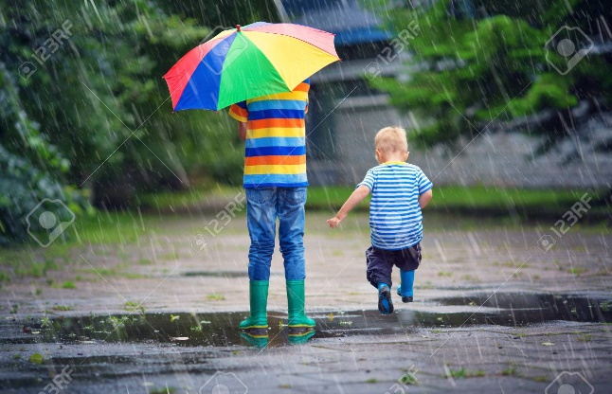
Culture Educational
Speaking
Being able to express your opinion
Listening
Active Listening with understanding
Creativity
Adding new thoughts to the discussion
Questions
Team Building
Asking poignant questions
.
Each individual needs to find the most suitable way to climb a mountain
5 hindrances to rid yourself of
Sensual desire
Aversion
Dullness / heaviness
Restlessness
Skeptical doubt
Create a word bank for discussion
Learn to accept and acknowledge
What do you know about yourself?
connection
Sharing
What is an obsession for you
Structure life to prevent the hindrances
…
JUST LET IT RAIN
Christopher Bauman – www.chrisbauman.com.au

Slide 2
1. What is a privilege? ____________________________________________________________________________________________?
Advanced Question Words
2. What is important in this lifetime? ___________________________________________________________________________________________ ?
Mental training
3. What is sharing / What is connection? ___________________________________________________________________________________________ ?
Sharing with others
4 Have you climbed to the top of a mountain? What did you see? Describe the mountain. ___________________________________________________________________________________________ ?
Monkey mind
5. When you see more clear means you can distinguish the proper direction and the right decisions to make ___________________________________________________________________________________________ ?
Describe a traveler
unmotivated
6. What is something that is trapping you and how can you get out of that cell? ___________________________________________________________________________________________ ?
imprisonment
clarity
7. Do you travel into the future or into the past? ___________________________________________________________________________________________ ?
Disconnected
Unique
8. Our lives are too unique to copy the path of someone else __________________________________________________________________________________ ?
I am not the body
I am not the mind
I am not my emotion
Describe a traveler who you have met?
Describe yourself as a traveler?
Christopher Bauman – www.chrisbauman.com.au

